Slide 1


UAIC Info Session
The world’s first undergraduate activist investing club
Fall 2026 Recruitment
Notes:
Welcome. Agenda: what activist investing is, what we do, events, advisors, placements, and how to apply before Friday.

Slide 2
What is activist investing?
Acquiring a stake in a public company believed to be worth more than its share price reflects, then pressing for changes to close that gap.
1
2
3
4
Find the gap
Build a stake
Push for change
Escalate if needed
A good company whose share price undervalues what it could be worth.
Buy enough shares to have a credible voice with management and the board.
A revised strategy, asset sales, cost reductions, capital returns, or new leadership.
From private engagement to public letters, board nominations, and proxy contests.
Notes:
Activists are long-term owners who see a gap between price and value, and do the work to close it.

Slide 3




What we do
Guest Speakers
Educational Sessions
Activist Investment Pitches
Recruiting Bootcamp
Leading investors, advisors, and executives who have shaped some of the most notable activist campaigns.
A structured curriculum from financial analysis and valuation to capital allocation, governance, and activist strategy.
Small groups develop an activist thesis on a public company, with recommendations published each quarter.
Accounting, valuation, modeling, and interview prep for banking, private equity, and finance, with mock interviews.
Notes:
Four programs: speakers, education, pitches, and recruiting prep.

Slide 4







Leading activist investors
Paul Singer
Nelson Peltz and Peter May
Bill Ackman
Jeff Smith
Icahn Enterprises
Carl Icahn
Dan Loeb
Mason Morfit
Barry Rosenstein
Notes:
The firms that define the field. Peter May of Trian is an emeritus trustee of the University of Chicago.

Slide 5
Key dates
Sep 28
Oct 4
Oct 9
Nov 5
Monday
Sunday
Friday
Thursday
Applications Open
Info Session
Applications Close
Guest Speaker
On our website
4:00 PM CT on Zoom
11:59 PM CT
Scott Ostfeld, 4:00 PM CT
Applications are reviewed on a rolling basis. Apply early, ahead of the October 9 deadline.
Notes:
Applications opened Monday. Deadline is this Friday at 11:59 PM Central. Review is rolling.

Slide 6
Application process
Written Application
Final Interview
Tell us about yourself and why you want to join.
A second conversation with our leadership team.
Due Friday, October 9
Rolling Interviews
1
2
3
4
First Interview
Welcome to the Club
A conversation with our leadership team.
New member education begins.
Rolling: Starts Monday (10/5)
Fall Quarter, Week 4
Notes:
One written application, then two conversations with the leadership team. No finance background needed.

Slide 7
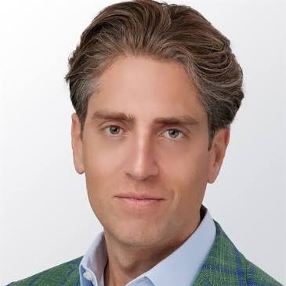
Events
Scott Ostfeld
Managing Partner and Portfolio Manager, Jana Partners
Jana Partners is a leading activist investing firm with over two decades of experience and $2.4 billion in assets under management. It has led campaigns at Whole Foods, Apple, Six Flags, and PetSmart. Scott serves on the boards of Lamb Weston and Mercury Systems.
Thursday, November 5, 2026
4:00 PM CT
Notes:
Our first speaker this quarter.

Slide 8
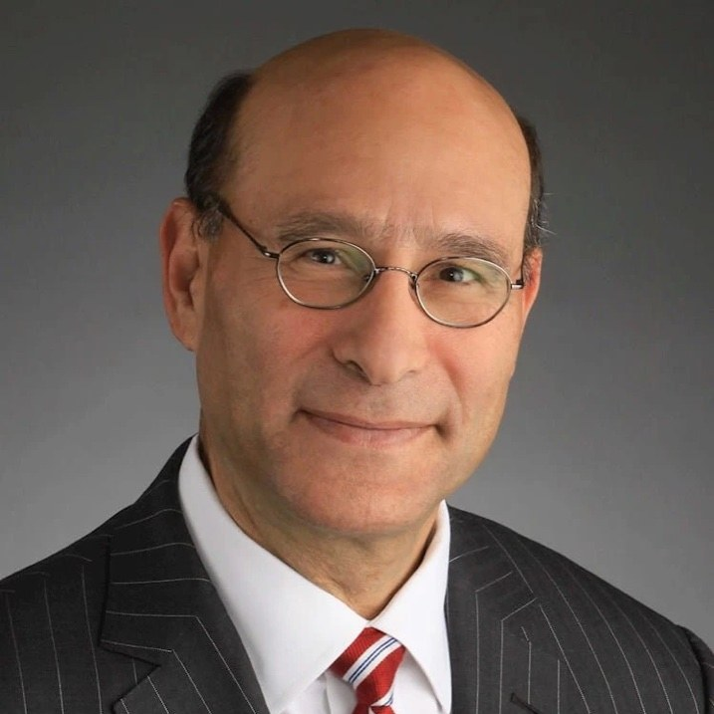
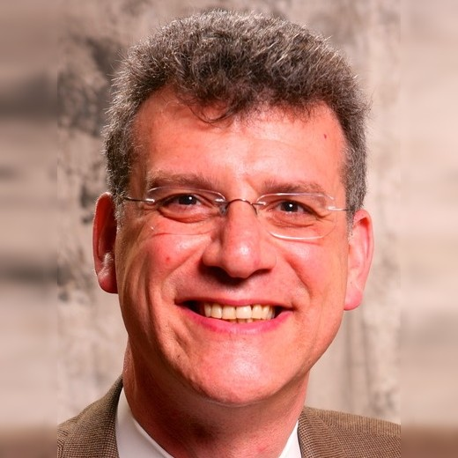
Advisors
Robert Schriesheim
Michael R. Levin
Adjunct Associate Professor of Finance, Chicago Booth
Activist Investor and Board Chair, Comarco, Inc.
Chairman of Truax Partners, advising boards, CEOs, and institutional investors on corporate transformations. He has served on 13 public company boards and as CFO of five public companies, including Sears Holdings, and sits on the boards of Houlihan Lokey, Skyworks Solutions, and Alight.
An activist investor and management consultant with almost thirty years of experience in investing, corporate finance, and equity turnarounds. He chairs the board of Comarco, serves on the board of AG&E Holdings, and holds bachelor’s and master’s degrees in economics from UChicago.
Notes:
Our advisors bring boardroom and activist experience.

Slide 9











Placements
Notes:
Where our members have interned and worked.

Slide 10
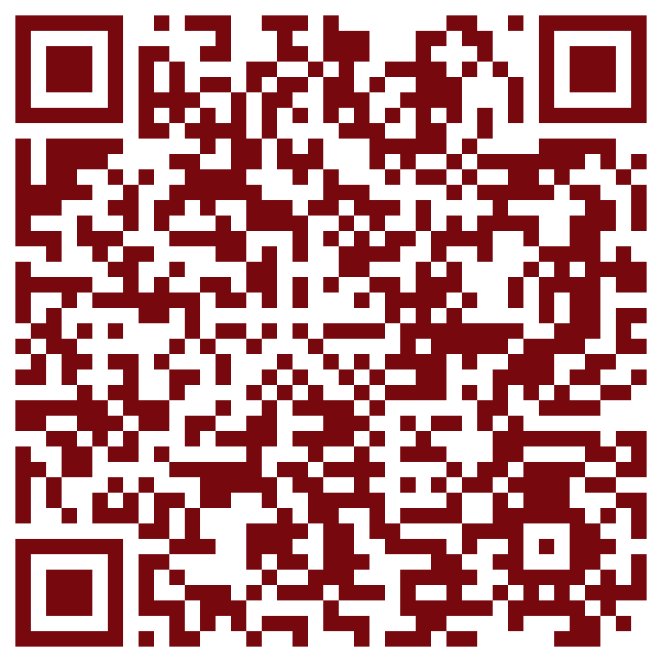
Thank you
Any questions?
Applications close Friday, October 9 at 11:59 PM CT.
Scan to apply
Notes:
Scan the code to apply. Deadline Friday at 11:59 PM Central.

